Slide 1



Malware
Malicious software that compromises computer systems.

Slide 2

Malware
Malware, short for malicious software, refers to any software specifically designed to harm or exploit computer systems, steal data, disrupt operations, or gain unauthorized access. It poses a significant threat to cybersecurity.

Slide 3
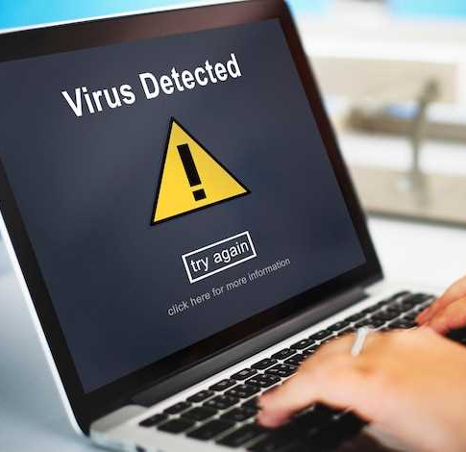
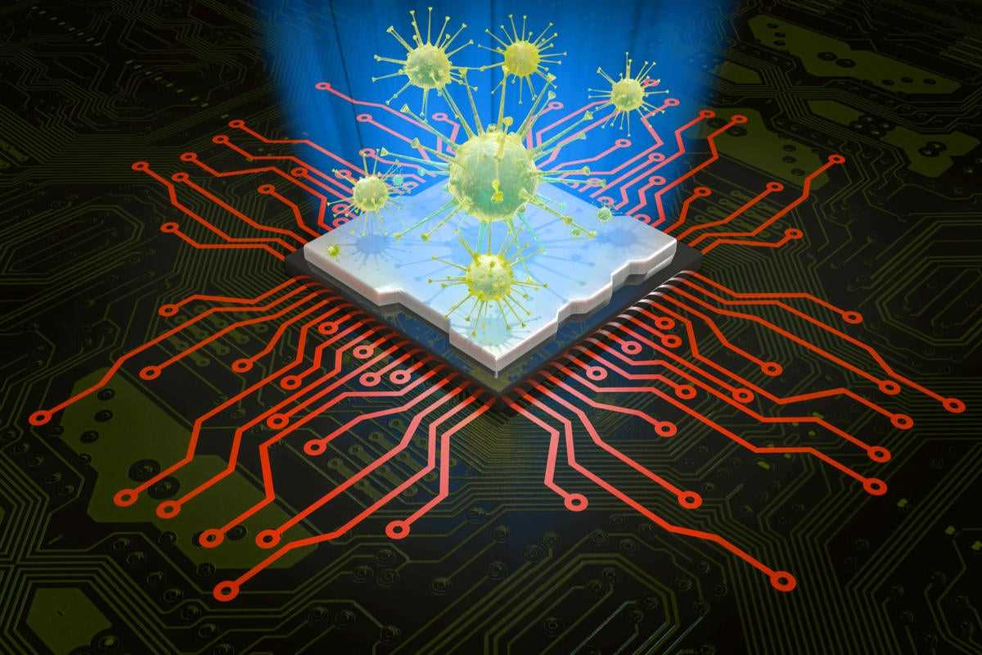
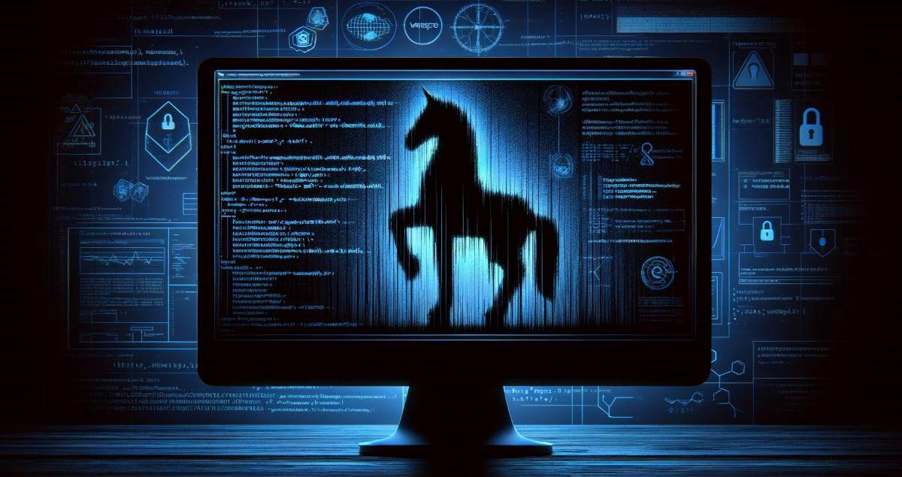
Types Of Malware
Viruses
Worms
Trojans

Slide 4

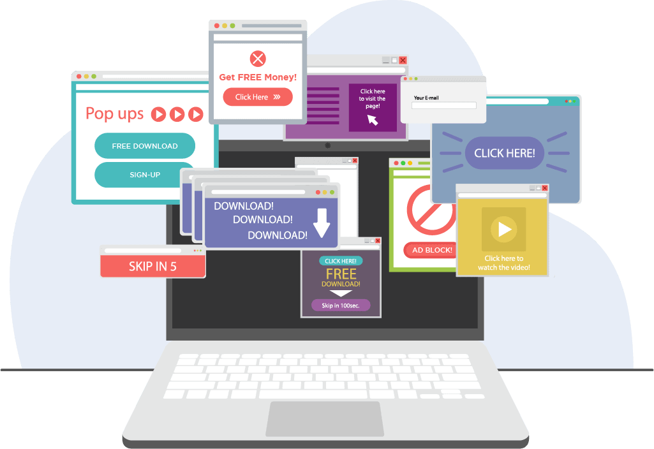

Types Of Malware
Ransomware
Adware
Spyware

Slide 5
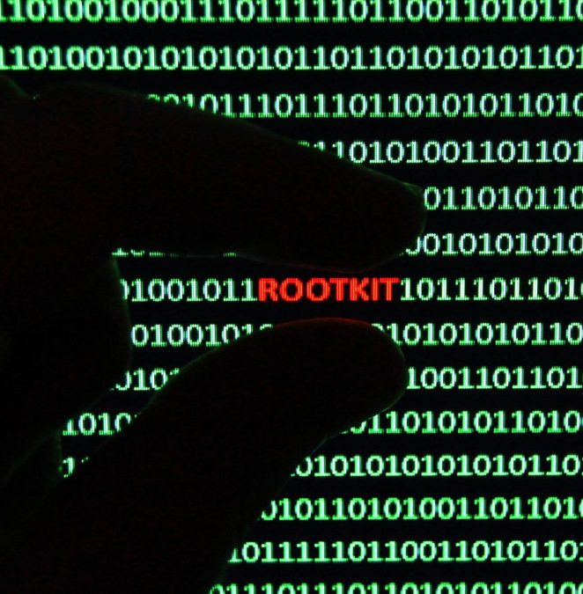


Types Of Cyber Security
Rootkits
Keylogger
Malicious cryptomining

Slide 6

Malware Analysis
Malware analysis involves dissecting malicious software to understand its structure, behavior, and impact. The goal is to identify its characteristics, origin, and functionality to mitigate its threat and prevent future attacks. This process includes various types of analysis, best practices, and key stages that help in comprehensively understanding and neutralizing malware threats.

Slide 7

Type of Malware Analysis
Static Malware Analysis
Examines malware files without executing the code, identifying harmful elements like filenames, IP addresses, and domains using tools like network analyzers.
Dynamic Malware Analysis
Involves running the malware in a sandbox—an isolated virtual environment—allowing safe observation of its behavior without risking system infection.

Slide 8

Stages of Malware Analysis
01
Static properties analysis
02
Interactive behavior analysis
03
Fully automated analysis
04
Manual code reversing

Slide 9
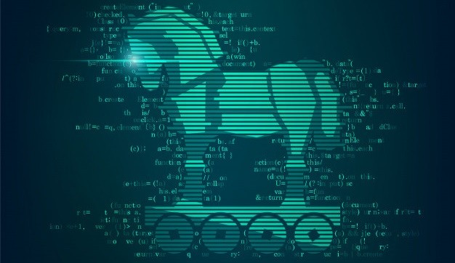
What’s a Trojan
A Trojan is a type of malware that hides within a legitimate file or program to gain access to your device. Because Trojan malware is delivered inside a legitimate app or file, it’s very difficult to detect. Trojans are used to spy on victims, steal data, infect other programs, and inflict other harm.

Slide 10
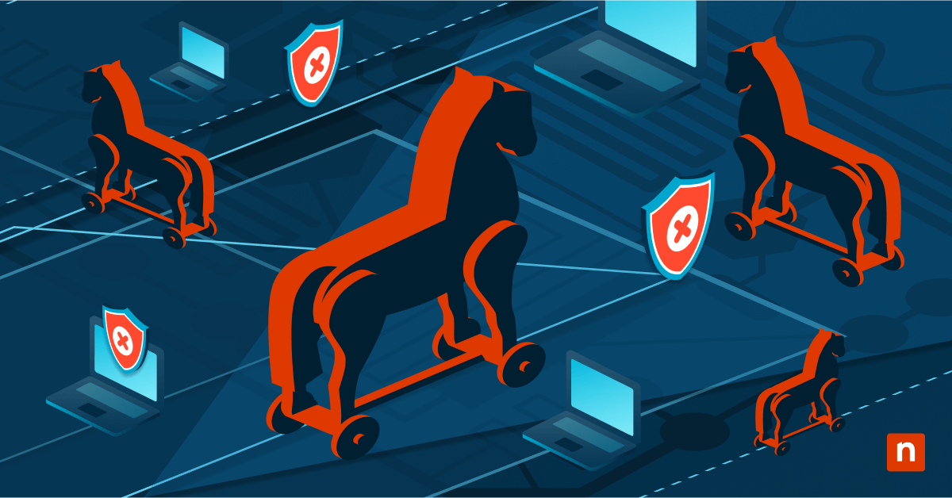
Types of Trojans
Backdoor Trojans
Remote Access Trojan (RAT)
Banking Trojans
DDoS Trojan

Slide 11
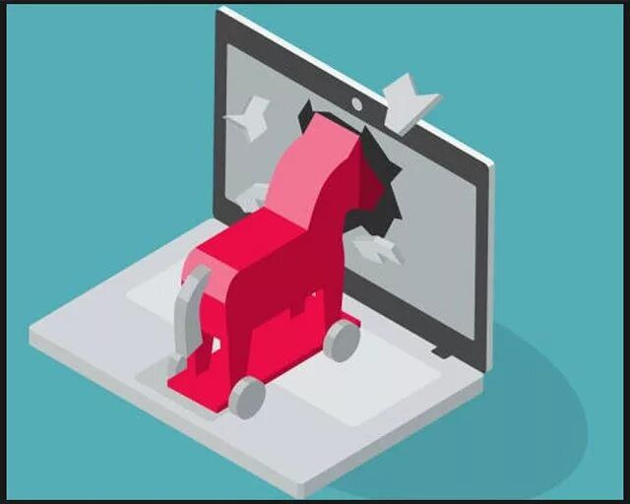
How do Trojans actually work?
Trojans work by disguising themselves as legitimate software or files to trick users into downloading and installing them. Once installed, they create a backdoor that allows attackers to remotely control the infected device. Trojans can steal data, monitor user activity, or even install additional malware without the user's knowledge. Unlike viruses or worms, Trojans do not self-replicate.

Slide 12
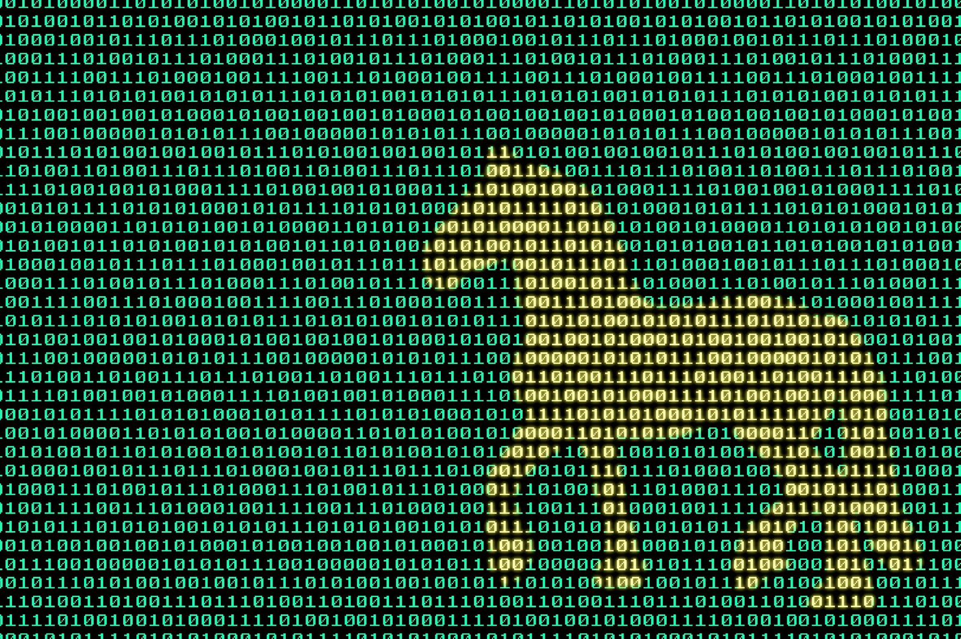
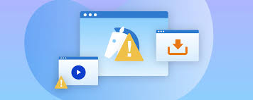
Prevention and Mitigation of Trojans:
Use Antivirus and Anti-Malware Software
Do not download from untrusted sources
Avoid phishing assaults
Update your Operating framework and any introduced security conventions
Do not visit dangerous sites

Slide 13
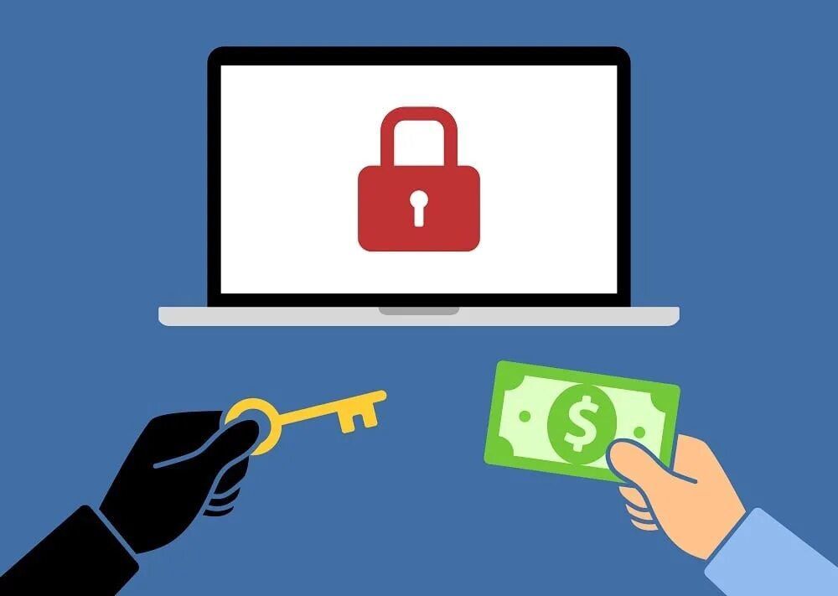
What’s ransomware
Ransomware is a type of malware that holds a victim’s sensitive data or device hostage, threatening to keep it locked—or worse—unless the victim pays a ransom to the attacker . The earliest ransomware attacks simply demanded a ransom in exchange for the encryption key needed to regain access to the affected data or use of the infected device

Slide 14
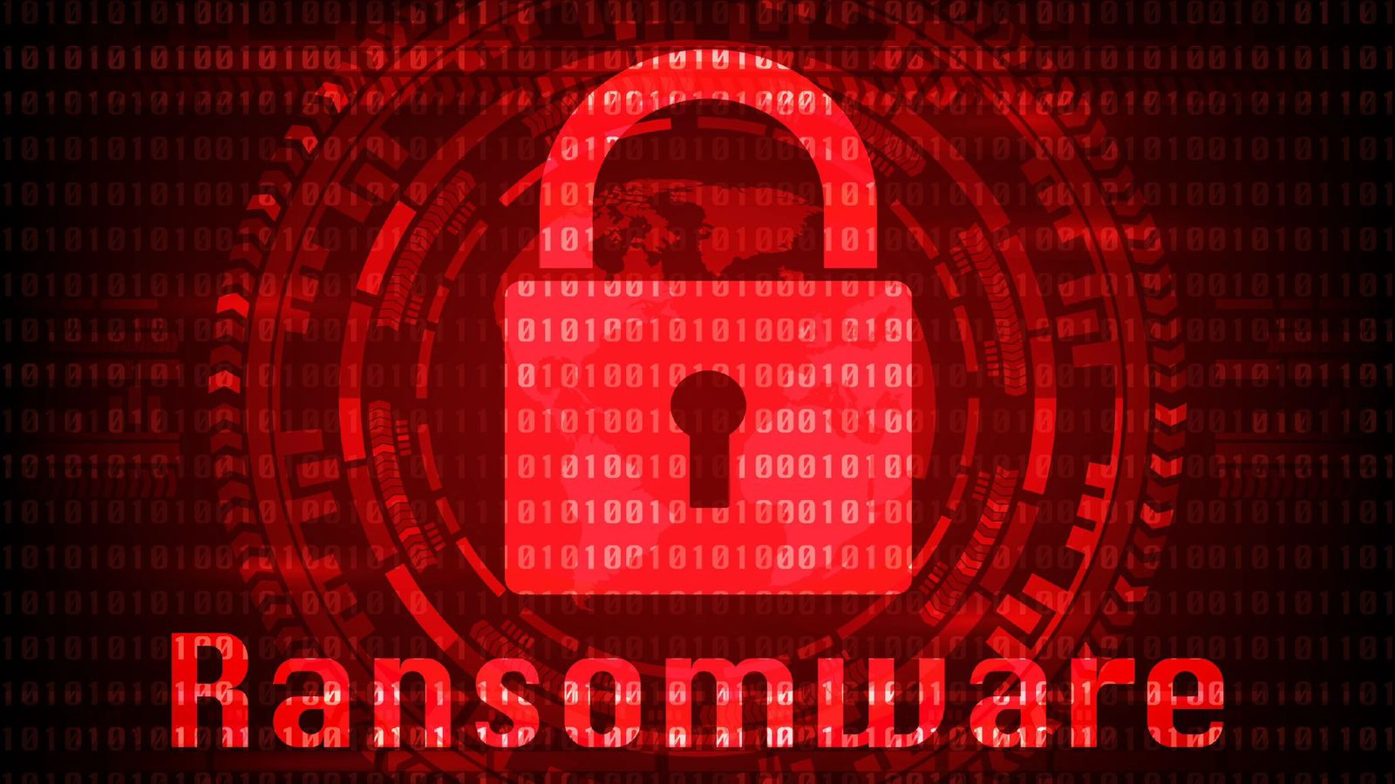
Types of ransomware
Leakware or doxware
Mobile ransomware
Wipers
Scareware

Slide 15
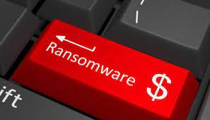
How does Ransomware actually work?
Ransomware infiltrates a system through phishing emails, malicious links, or software vulnerabilities. Once inside, it encrypts files, making them inaccessible to the user. The attacker demands a ransom, usually in cryptocurrency, in exchange for a decryption key. If the ransom isn’t paid, the attacker may threaten to delete or leak the data. Ransomware can also spread across networks, affecting multiple devices or systems.

Slide 16

Prevention and Mitigation of Ransomware
Never click on unverified links
Scan emails for malware
Use firewalls
Only download from trusted sites
Keep backups of important data
Use security software
Do not use unfamiliar USB devices
Avoid giving out personal data

Slide 17
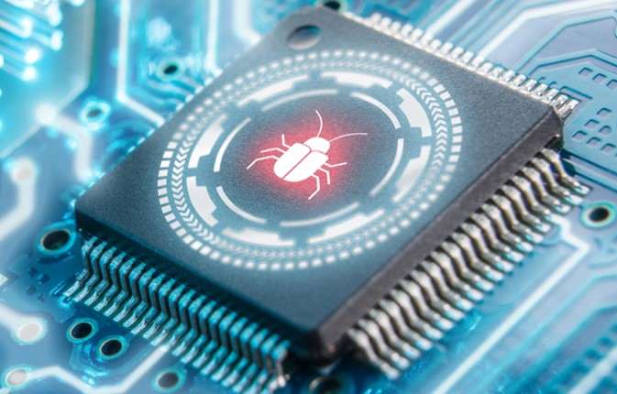
What’s a rootkit
A rootkit is a type of malicious software designed to gain unauthorized access to a computer or network while hiding its presence. It typically allows attackers to maintain control over the system, manipulate processes, and access sensitive data without detection. Rootkits can modify system files and processes, making them difficult to identify and remove, and can be used to facilitate other types of malware or attacks.

Slide 18
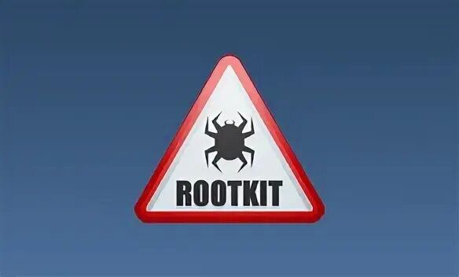
Types of rootkits
User-Mode Rootkits
Kernel-Mode Rootkits
Bootloader (Bootkit) Rootkits
Firmware Rootkits
Hypervisor Rootkits (Virtualized Rootkits)

Slide 19
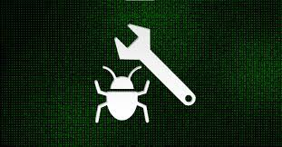
How does Rootkits actually work?
Rootkits are malicious software that install themselves deeply in the operating system, often at the kernel level. They gain administrative access, allowing them to bypass security measures. Rootkits conceal their presence by modifying system files and processes, making detection difficult. Once installed, they can monitor user activities, log keystrokes, and execute commands remotely, while ensuring persistence by running automatically at system startup.

Slide 20
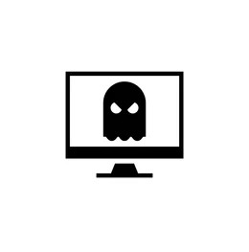
Prevention and mitigation
Behavioral Analysis
File Integrity Monitoring (FIM)
Boot-Time Scans
Hardware-Based Detection
Digital Signatures

Slide 21


What are SIEM Solutions?
01
Security Information Management (SIM)
Security Information and Event Management (SIEM) is a comprehensive approach to managing an organization's security posture. A SIEM solution combines two critical cybersecurity functions
02
Security Event Management (SEM)

Slide 22

At its core, a SIEM solution acts as the central nervous system of an organization's cybersecurity operations. It collects data from multiple sources, including
01
02
03
Network devices
Applications
Servers
04
Cloud services
05
Security tools (firewalls, antivirus software, intrusion detection systems)

Slide 23

How Does Malware Spread?
01
Infected Attachments
02
Compromised Websites
03
Downloads
USB Drives
04
05
Image

Slide 24

Conclusion
In an increasingly connected world, cyber security is paramount. Protecting our systems, networks, and data is essential to safeguarding privacy, preventing cyber attacks, and ensuring trust and stability in the digital landscape.

Slide 25


Slide 26


Types Of Cyber Security
Network Security
Endpoint Security
Data Security

Slide 28
Icons

Slide 29
Icons

Slide 30
How To Edit Shapes
You can add and edit some shapes to your presentation to present your data in a visual way.
Choose your favourite infographic and insert it in your presentation using Ctrl C + Ctrl V or Cmd C + Cmd V in Mac.
Select one of the parts and ungroup it by right-clicking and choosing “Ungroup”.
Change the color by clicking on the paint bucket.
Then resize the element by clicking and dragging one of the square-shaped points of its bounding box (the cursor should look like a double-headed arrow). Remember to hold Shift while dragging to keep the proportions.
Group the elements again by selecting them, right-clicking and choosing “Group”.
Repeat the steps above with the other parts and when you’re done editing, copy the end result and paste it into your presentation.
Remember to choose the “Keep source formatting” option so that it keeps the design. For more info, please visit Slideegg (Tips & Tricks).

Slide 31
Terms Of Use (Free Users)
If you are a free subscriber, you should credit SlideEgg by keeping the “ThankYou” slide.
Kindly refer to the following slide for the Terms of Use for premium users.
You can:
Customize or edit this template
Use this template for both business and personal endeavors.
You can not:
Sell, rent, or second-license SlideEgg content or its altered version. Promulgate, unless explicitly permitted, SlideEgg content, by SlideEgg.
Incorporate SlideEgg content in any database or file online or offline.
Obtain SlideEgg content’s copyright.
Kindly refer to our Tutorial page or FAQ for advanced slide modification guidelines.

Slide 32
Terms Of Use (Premium Users)
Being a premium subscriber, you have the privilege of using this PPT template
without giving attribution to SlideEgg or keeping the “ThankYou” slide.
You can:
Customize or edit this template.
Use this template for both business and personal endeavors.
Circulate or share the editable format of this template with anyone you want.
You can not:
Sell, rent or second-license SlideEgg content or the altered version of it. Promulgate or include the templates in any other services database
that performs as distribution or resale platform, unless explicitly permitted, by SlideEgg.
Incorporate the elements used in SlideEgg’s templates separately.
Obtain SlideEgg’s copyright for the elements used in this template as a logo or trademark.
Kindly refer to our Tutorial page or FAQ for advanced slide modification guidelines.

Slide 33





Thank You!
We respect your valuable time with SlideEgg!
If you have any questions, please reach us
Do you have a design request, please visit our redesign page.
CREDIT: SlideEgg created this PowerPoint template.
Let this slide be kept for attribution.
www.slideegg.com

